Slide 1

Analysis of Temperature Data Variation of Lucknow
Department of Civil Engineering
Indian Institute of Technology Guwahati
Assam, India - 781039
Course Instructor Dr. Archana M. Nair
Associate Professor, Dept of Civil Engineering
Presented by,
ALTMASH (244104002)

Slide 2
Content:-
Introduction & Overview of Lucknow's Climate
Historical Temperature Trends (1990-2022)
Extreme Temperature Events & Heatwaves
Geo-Hazards
Predicting Future Trends with Machine Learning
Mitigation & Adaptation Strategies
Conclusion
References

Slide 3
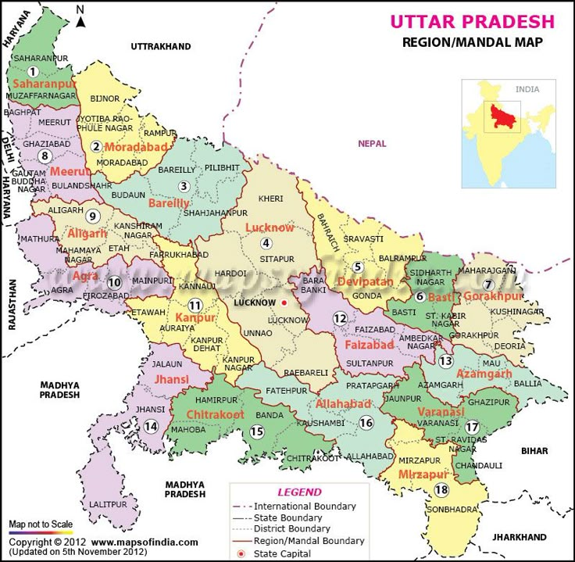
1.Introduction & Overview of Lucknow's Climate
Climate significantly influences agriculture, health, infrastructure, and ecosystems.
Lucknow shows a typical continental climate with rising temperature extremes.
Understanding patterns helps predict future risks and guide mitigation efforts.
Geographical Location: 26.8°N, 80.9°E
Continental Climate: Hot summers, cold winters
Observed at Amausi since 1948
Four seasons: Winter, Summer, Monsoon, Post-Monsoon
Fig.1 Study Area

Slide 4
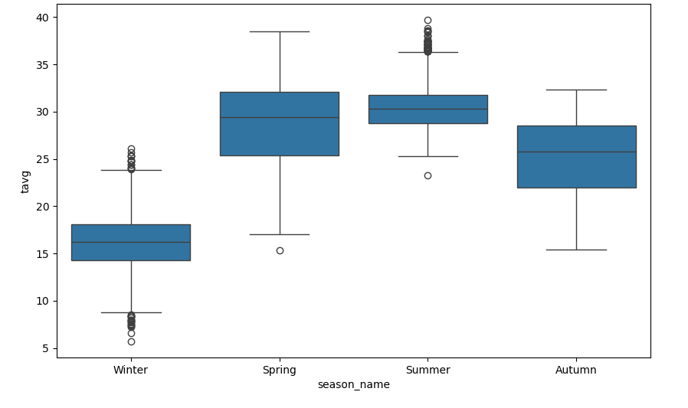
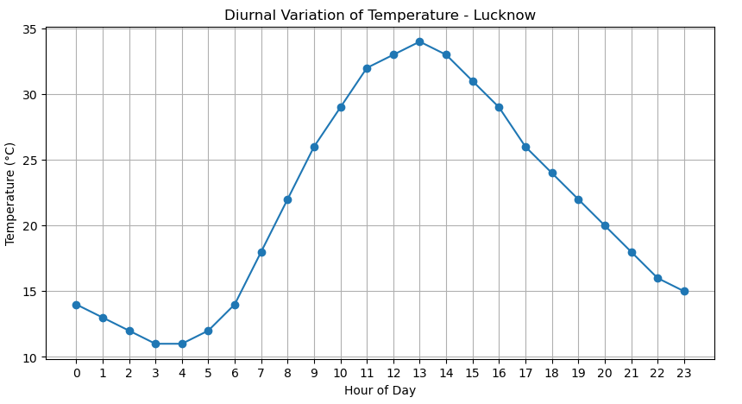
1.1 Seasonal and Diurnal Variation:
Fig 1.1 Seasonal Average Variations
Fig 1.2Average Diurnal Variations

Slide 5
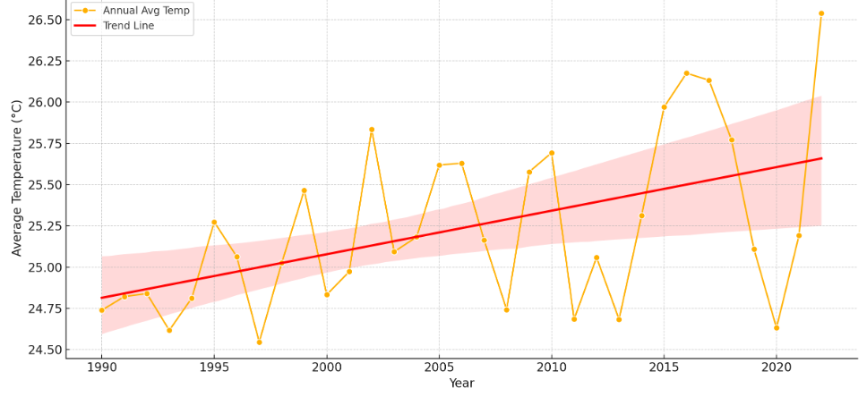
2. Historical Temperature Trends (1990-2020)
Maximum summer temperature rising above 45°C frequently
Average summer temperatures have risen by ~1.5°C since 1990
Winters show less severe cold days, indicating warming
Heatwaves increased, cold waves decreased
Fig 2. Historical Average Temperature Trends (1990-2022)

Slide 6
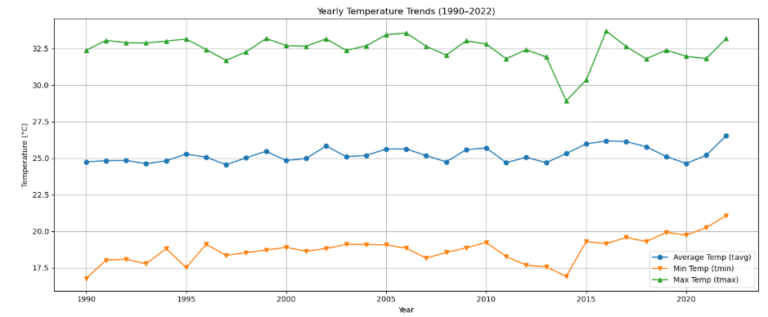
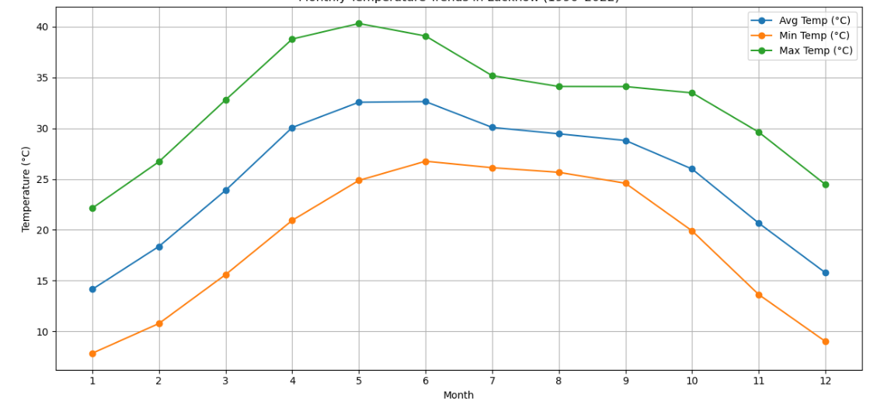
2.1 Yearly and Monthly Temperature Trends
Fig 2.1 Yearly Average Temperature Trends
Fig 2.2 Monthly Average Min. and Max. Temperature Trends

Slide 7
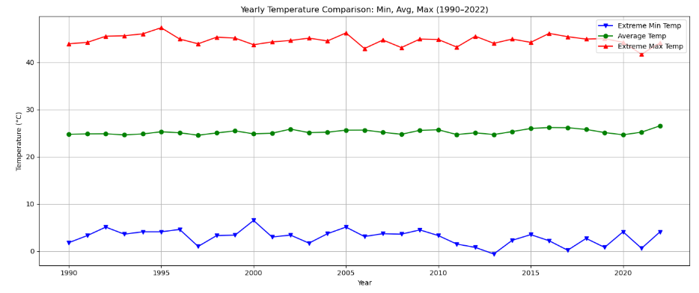
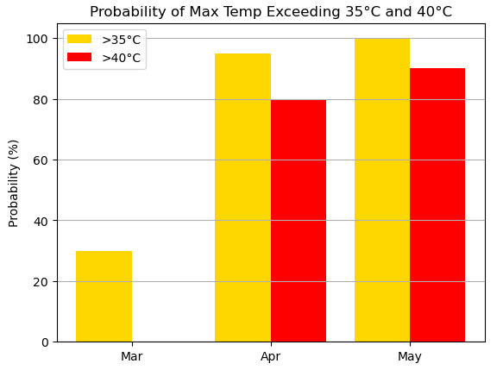
3. Extreme Temperature Events
Fig 3.1 Yearly Average Extreme Temperature Comparisons
Fig 3.2 Probability of Max Temp Exceeding 35 Degree and 40 Degree Celsius

Slide 8
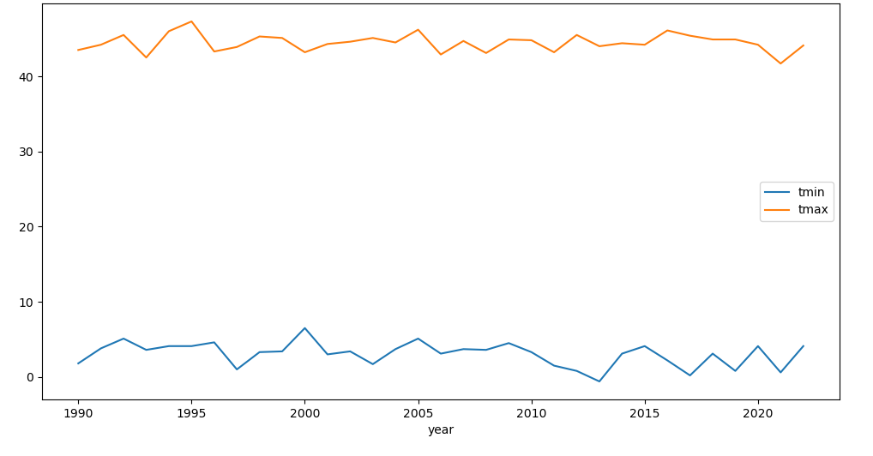
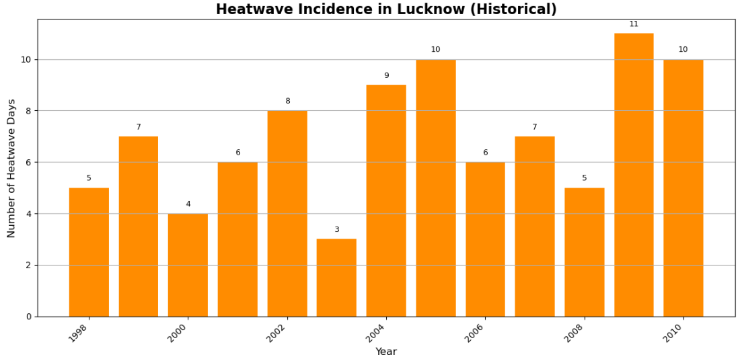
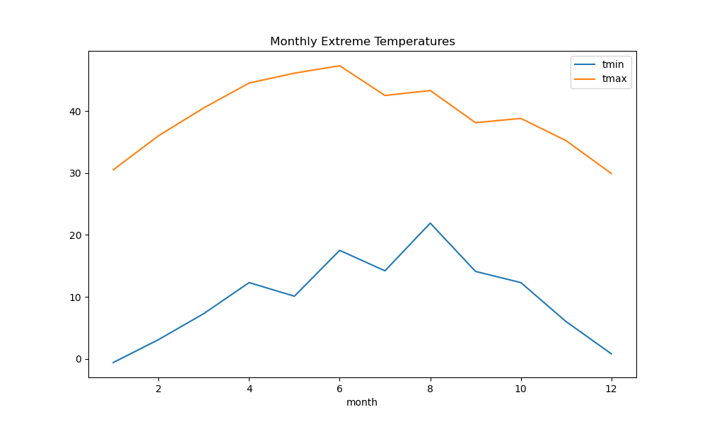
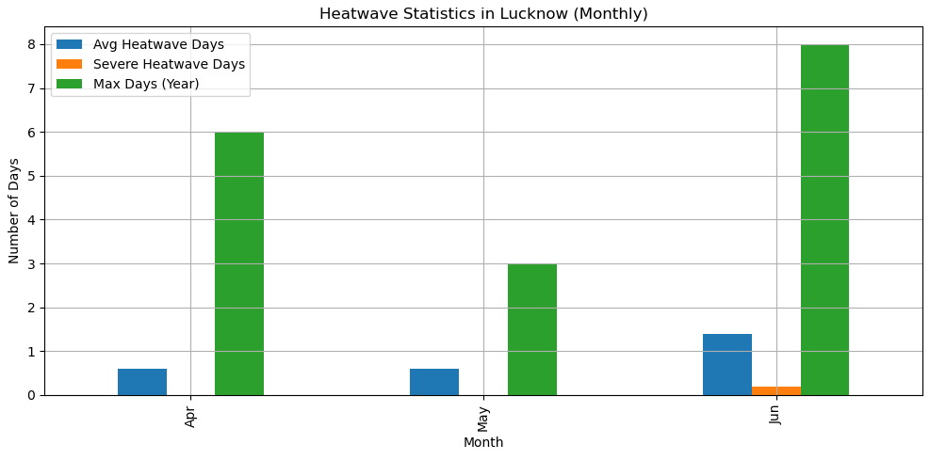
3.1 Extreme Temperature and Heatwave Events
Fig 3.3 Yearly Extreme High and Low Temp
Fig 3.4 Yearly Heatwave Incidence
Fig 3.5 Monthly Extreme High and Low Temp
Fig 3.6 Monthly Average Heatwave Days

Slide 9
4. Geo-Hazards in Lucknow
Public Health Impacts
Heatwaves
Longer duration, higher frequency
Increased mortality risk in elderly and children
Droughts:
Erratic rainfall patterns
Soil moisture depletion, impacting agriculture
Urban Flooding
Heavy rainfall in short bursts during monsoon

Slide 10
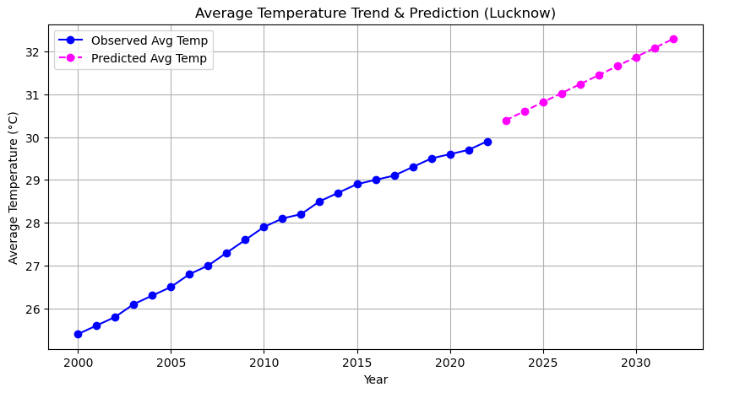
5. Future Predictions Using Machine Learning
Techniques: Linear Regression, LSTM (Deep Learning)
Features Used:
Monthly Avg Temp
Output:
Predicted Avg Temp for next 10 years
Findings:
Projected rise of ~1.8°C in next decade if current trend continues
Fig 5. Average Temp Trend and Prediction For next 10 Years

Slide 11
6. Mitigation and Adaptation Strategies
Urban Planning:
Green roofs, reflective surfaces, shaded streets
Water Management:
Rainwater harvesting, efficient irrigation
Early Warning Systems:
For heatwaves and drought risk
Policy Interventions:
Climate-resilient agriculture, urban infrastructure standards

Slide 12
7. Conclusion
Lucknow is getting warmer every year.
Heat waves are starting earlier and lasting longer.
Night temperatures are rising.
Monsoon is arriving earlier in some years.
Extreme temperature events are happening more often.
Machine learning models predict more warming in the future.
Climate action is needed to reduce risks and protect the city.

Slide 13
8. References
India Meteorological Department (IMD) Data: 1990–2022
"Climatology of Lucknow" by O.P. Singh, J.P. Gupta & A.H. Warsi, published by National Data Centre, IMD Pune
CSV Dataset: "Lucknow_1990_2022.csv" from Meteorological Observatory at Amausi, Lucknow

Slide 14
Thank You

